Slide 1


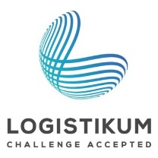


Future Trends in Freight Transport
Notes:
This set of slides provides an overview of the topic "Future trends in freight transport" and addresses the need for alternatives in freight transport and possible solutions by optimizing existing means of transport, visionary means of transport and innovative transport concepts.

Slide 2
How to work with this learning material
Power Point
  The following PowerPoint presentation presents “future trends in freight transport”. The slides are shortly described in the respective notes below, which also provide the link to the source if you need further information.
Reader
In addition to the power point presentation, you can also use the reader provided on our platform. It is more detailed and can be used as a script for your lessons.
Exercises
The learning packages contain various interactive exercises to consolidate the acquired knowledge. Solutions for the exercises are also provided.
Links
  You can find the sources of our presentation and reader in the link section of the respective bundled teaching material.
Videos
    There are various videos used as sources in this presentation. You can find these videos separately in the overview section of the bundled teaching materials.

Slide 3
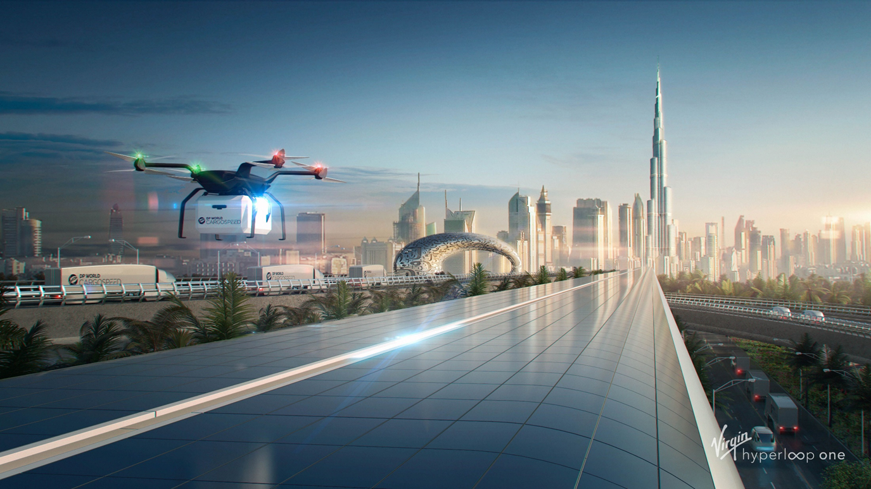
Warm-Up: Discussion
Which visionary means of
transport do you know?
Which optimisations of existing means
of transport are you aware of?
Source:
Notes:
The questions in this slide can be used as a warm-up exercise on the topic "Future trends in freight transport". The goal is to discuss the questions with the pupils / students / participants. The questions will be answered during the presentation. As a result, the questions can be discussed again at the end of the presentation.
Increasing global freight traffic is leading to an increasing congestion of the transport infrastructure. Road transport in particular is increasingly reaching its limits, which is reflected in increasing congestion. Environmental pollution is also increasing: rising CO2 emissions, fine dust pollution and noise pollution are the result. New visionary means of transport as well as the optimisation of existing means of transport are necessary to shift traffic accordingly and to relieve the burden on road transport.
Discussion questions (5-10 minutes discussion):
Which visionary means of transport do you know?
Which optimizations of existing means of transport do you know?
The questions are intended to determine the current level of knowledge of students / participants on the content of this teaching material package
Input- possible discussion points:
Visionary means of transport: Hyperloop, drones, transport airship, Cargo Sous Terrain
Optimization of existing modes of transport: autonomous driving (e.g., platooning), alternative fuels (LNG, electricity)
Transport concepts: synchromodality
Source:
Virgin Hyperloop One (2019). URL: https://www.dropbox.com/sh/6pejtkr49pljjyb/AAD5kjKUgJAvDIf1jhAo_wNha?dl=0&preview=Virgin_Hyperloop_One_2.jpg [17.06.2019]

Slide 4
Agenda
Future Trends in Freight Transport
Why we need alternatives in freight transport
Innovative transport concepts
Visionary means of transport
Optimisation of existing means of transport

Slide 5

Freight transport causes high external costs for society
Congestion: costs the EU around 1% of GDP each year (rising trend)
Dependency on oil imports: 96 % of the energy demand of transport covered by crude oil (energy consumption increased by 29% since 1990)
External costs of EU transport:
1 billion euros per year (infrastructure costs not included) according to study by the EU-Commission
Infrastructure: developed differently in the EU
Competition: more competition needed within the EU, much international competition
Data source: INRIX 2018
23 % of global CO₂ emissions generated by the transport sector =
1/3 of total final energy consumption
Notes:
Increasing freight traffic leads to congestion of the road infrastructure. The associated congestion costs the European Union around 1% of GDP per year and these costs are expected to continue to rise. With an average of 25 hours of congestion in 2017, Austria is among the top 10 EU countries suffering this problem (see Figure). This value has remained unchanged since the last measurement in 2014. The current data on European cities from 2018 also paints a dramatic picture: The cities with the greatest time losses in rush hour traffic are Rome (254 hours), Dublin (246 hours), Paris (237 hours) and London (227 hours). In Vienna, too, motorists lose more than 100 hours a year in rush hour.
The dependence of the transport sector on oil imports remains high. 96% of the energy demand is currently covered by crude oil. Energy consumption in the EU transport sector increased by 29% between 1990 and 2016. This has led to a further shortage of oil resources and an increase in costs. The external costs of the transport sector have also risen rapidly. According to a study by the EU Commission, the external costs of EU transport amount to one billion euros per year. Infrastructural costs are not yet included.
The EU has set itself the goal of further developing the transport infrastructure within the EU in order to ensure the competitiveness of the European economy. Furthermore, the eastern part of the EU, which is weaker in terms of transport infrastructure, is to be brought closer to the level of the western part, thus leading to a better distribution of the traffic load.
Source:
European Commission (2019): Urban mobility. Available online at https://ec.europa.eu/transport/themes/urban/urban_mobility_en, updated on 6/17/2019, checked on 6/17/2019.
Cookson, Graham (2018): INRIX Global Traffic Scorecard. INRIX Research. Available online at https://www.dmagazine.com/wp-content/uploads/2018/02/INRIX_2017_Traffic_Scorecard_Final_2.pdf, checked on 6/17/2019.
INRIX (2016): Traffic Scorecard. 2015. Available online at http://inrix.com/wp-content/uploads/2016/11/INRIX_2015_Traffic_Scorecard.pdf, checked on 6/17/2019.
INRIX (2019): Interactive Ranking & City Dashboards. Available online at http://inrix.com/scorecard/, checked on 6/17/2019.
European Commission (2011): White paper on transport. White paper on transport. Roadmap to a single european transport area – towards a competitive and resource-efficient transport system. Available online at https://ec.europa.eu/transport/sites/transport/files/themes/strategies/doc/2011_white_paper/white-paper-illustrated-brochure_en.pdf, checked on 6/5/2019.
European Environment Agency (2018): Final energy consumption by mode of transport. Available online at https://www.eea.europa.eu/data-and-maps/indicators/transport-final-energy-consumption-by-mode/assessment-9, checked on 6/17/2019.
European Commission (2018): Multimodal Sustainable Transport: which role for the internalisation of external costs? Available online at https://ec.europa.eu/transport/sites/transport/files/2018-year-multimodality-external-costs-note.pdf, checked on 6/17/2019.

Slide 6
A sustainable solution for transport is urgently needed
European Commission‘s White Paper “Roadmap to a single European transport area – Towards a competitive and resource-efficient transport system”
    Contains proposals for measures by the EU to make transport more sustainable in the future
    Rail and inland waterway are declared as sustainable modes of transport
    → Goal: Modal shift
    alternative fuels
    alternative means of transport
60% emission reduction: By 2050 compared with 1990 levels
    Goals of modal shift
    2030: 30 % of road traffic > 300 km to rail / inland waterway
    2050: 50 % of road traffic > 300 km to rail / inland waterway
Notes:
The transport sector, as one of the main sources of CO2 emissions, is responsible for making a significant contribution to reducing emissions. 23% of global CO2 emissions are generated by the transport sector. This corresponds to almost one third of the total final energy consumption. The EU has set itself ambitious goals to counteract this negative development. By 2050, greenhouse gas emissions are to be reduced by 60% compared with 1990 levels, thus contributing to limiting global warming to 2°C. As emissions actually increased by 27% between 1990 and 2009, the EU must achieve an overall reduction of 68% between 2009 and 2050.
The European Commission's 2011 White Paper "Roadmap to a single European transport area – Towards a competitive and resource-efficient transport system" contains proposals for measures by the EU to make transport more sustainable in the future. The "rail" and "inland waterway" modes of transport are defined as sustainable modes of transport and a modal shift from road to inland waterway is being pursued. By 2030, 30% of road traffic with a distance of more than 300 km is to be shifted to rail or inland waterways, and by 2050 this figure will rise to 50%. In addition to a shift in means, the use of alternative fuels is to be promoted and alternative means of transport developed to ensure a reduction in emissions by the transport sector.
Sources:
Sims, R.; Schaeffer, R.; Creutzig, F.; Cruz-Núñez, X.; D’Agosto, M.; Dimitriu, D. et al. (2014): Transport. In O. Edenhofer, R. Pichs-Madruga, Y. Sokona, E. Farahani, S. Kadner, K. Seyboth et al. (Eds.): Climate Change 2014: Mitigation of Climate Change. Contribution of Working Group III to the Fifth Assessment Report of the Intergovernmental Panel on Climate Change. Cambridge, United Kingdom and New York, NY, USA: Cambridge University Press. Available online at https://www.ipcc.ch/site/assets/uploads/2018/02/ipcc_wg3_ar5_full.pdf, checked on 6/17/2019.
European Commission (2011): White paper on transport. White paper on transport. Roadmap to a single european transport area – towards a competitive and resource-efficient transport system. Available online at https://ec.europa.eu/transport/sites/transport/files/themes/strategies/doc/2011_white_paper/white-paper-illustrated-brochure_en.pdf, checked on 6/5/2019.

Slide 7
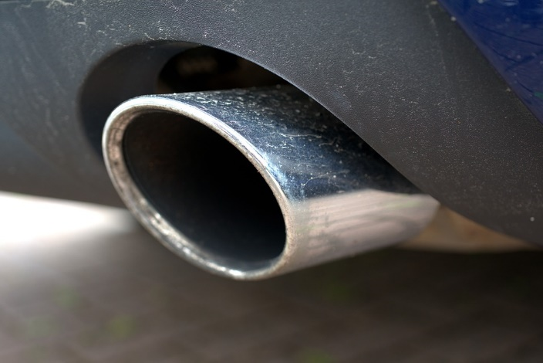
Why we need alternatives in freight transport
Quiz
What percentage of global CO2 emissions are generated by the transport sector?
12 %
23 %
57 %
30 %
Source: pixabay
Notes:
What percentage of global CO2 emissions are generated by the transport sector?
Answer: 23%
Source: https://pixabay.com/photos/about-diesel-exhaust-car-scandal-3538412/

Slide 8
Agenda
Future Trends in Freight Transport
Why we need alternatives in freight transport
Innovative transport concepts
Visionary means of transport
Optimisation of existing means of transport

Slide 9
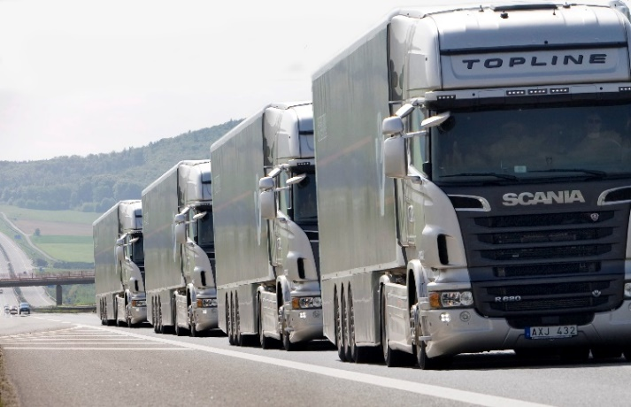
Automated driving - Platooning
Platooning = linking of two or more trucks in convoy, using connectivity technology and automated driving support systems
Possible through using driver assistance systems:
  Lane departure warning systems
  Distance regulators
  Trucks are networked with each other via WLAN
Advantages:
  Reduced air resistance
  Saving fuel and emissions
  Saving space on the motorway
  Reduced congestion due to even speed
Source: RSGB Limited 2014
Further information on technical optimisations of the transport mode „Road“ can be found in our RERoad – learning material package.
Notes:
The term "platooning" comes from the military sector and can also be described as a "truck convoy" or "networked columns". "Platooning" works like a classic freight train, only that no wagons but trucks are attached to each other. The individual trucks are networked with each other using innovative technologies (WLAN, GPS, Wi-Fi, etc.) and equipped with the latest systems (e.g. automatic braking systems, lane departure warning systems or distance regulators). The driving behaviour of the truck train is controlled by the first truck. The vehicles travel at a speed of about 80 km/h at a constant distance of about 5 m. The concept operates based on the fact that 10 trucks can be part of such a train, and, in the long run, that not only a network between the vehicles, but also with the infrastructure is to be made possible. The autonomous driving of trucks forms an important basis for this. The small distance between the vehicles reduces air resistance and thus enables fuel and emission savings of up to 20%. In addition, more efficient use of motorway space is achieved and traffic congestion is reduced due to the even speed.
Sources:
European Truck Platooning Challenge: What is Truck Platooning? - EU Truck Platoon Challenge. Available online at https://www.eutruckplatooning.com/About/default.aspx, checked on 6/19/2019.
Picture source:: RSGB Limited (2014): DfT commissions ‘platooning’ study. URL: http://roadsafetygb.org.uk/news/n-a-3301 [20.05.2019]

Slide 10
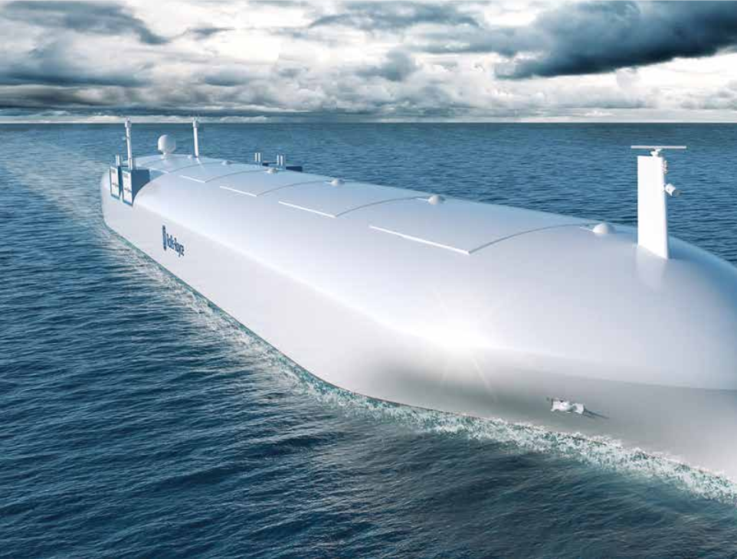
Automated driving: Autonomous cargo ships
Autonomous navigation is also seen as an opportunity for inland and ocean shipping
First major project funded by the
EU in 2018
Possibility for Ship Platooning
Objective:
  Phase 1: Remote-controlled vessel (by 2020)
  Phase 2: Autonomous ship (by 2025)
•
Source: Rolls Royce 2016
Further information on technical optimsations of the transport mode „Water“ can be found in our REWWAY – learning material package.
Notes:
Autonomous navigation is also seen as an opportunity for inland and ocean shipping to meet challenges such as competitiveness, safety and sustainability. These include advanced decision support systems that allow ships to be operated remotely under semi- or fully automated control. The Rolls-Royce company intends to use the first remote-controlled cargo ships in commercial ocean-going shipping operations by 2025. Control is provided by a control centre on land and is performed by captains using virtual reality glasses, who control the arrival and departure from the port. By 2035 the first fully autonomous ships are to be used in the commercial sector. Autonomous ships can reduce fuel consumption and associated emissions. There are no security risks associated with the crew, such as piracy and hostage-taking. Furthermore, shipping companies could save personnel costs and transport more goods, as these ships do not require crew accommodation. The European Commission has decided to grant 27.6 million Euro to support this project in order to further the development of this technology.
Sources:
Rolls-Royce (2016): Autonomous ships. The next step. Available online at https://www.rolls-royce.com/~/media/Files/R/Rolls-Royce/documents/customers/marine/ship-intel/rr-ship-intel-aawa-8pg.pdf, checked on 6/19/2019
Port Technology (2019): Autonomous Shipping Project Wins EU Investment. Available online at https://www.porttechnology.org/news/autonomous_shipping_project_wins_eu_investment, checked on 6/19/2019.
Video source:
Wall Street Journal (2016): Automated Cargo Ships: The Next Transport Revolution? URL: https://www.youtube.com/watch?v=Z5cTxSjjEXI [20.05.2019]

Slide 11
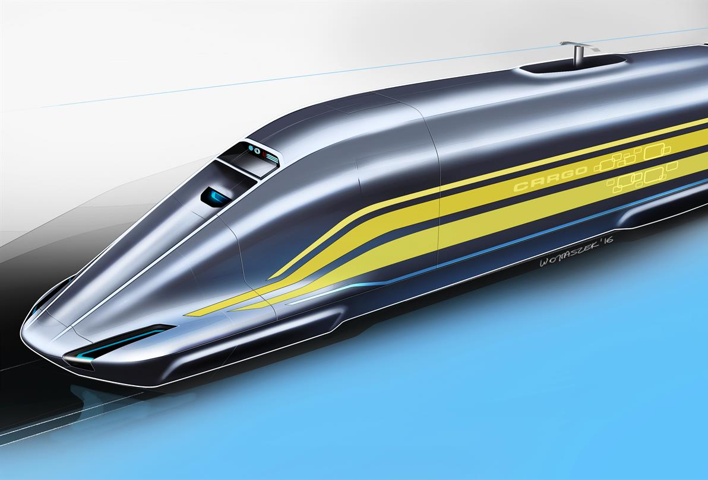
Automated driving: High speed freight train
DLR: Project Next Generation Train Cargo
  Economically & ecologically competitive
  Up to 400 km/h possible
  Wagons autonomously and individually manoeuvrable (own electric motor and battery)
  → can automatically and autonomously drive the last few kilometres to the customer
  Planned application on the new Silk Road
Objective: To increase the share of rail in freight transport
Challenge: Specialisation in transport of small, flexible and time-sensitive consignments (LDHV – Low Density High Value)
Source: Deutsche Luft- und Raumfahrt 2017
Notes:
Autonomous driving as a model for the future is also the subject of research into rail as a mode of transport. With the Next Generation Train Cargo (NGT-CARGO) project, the German aerospace industry has set itself the goal of developing fully automatic high-speed trains in order to increase the share of rail in freight transport. The NGT CARGO will be used, among other things, for the new Silk Road and establish the freight train as a competitor to container ships. The distance between China and Europe is to be reduced from 14 days to 3 days.
NGT CARGO trains are composed of individual cars and powerful traction units as required. The number of individual cargo wagons and traction units can be varied according to customer requirements by adjusting the maximum speed, whereby the system is designed for speeds of up to 400 km/h in the fastest configuration. The individual cargo wagons have their own low-power drive (20 km/h, 20 km range), an on-board energy storage system and an automatic coupling system. This enables fully automatic train formation and separation without the use of shunting locomotives. Due to the independent drive, the wagons can cover the last kilometres to connecting points and forwarding loading points autonomously. This could make rail transport more relevant again for small, flexible and urgent shipments (LDHV – Low Density High Value).
The full automation of trains also enables virtual coupling and decoupling of trains during travel. This operation is called dynamic flanking. The automatic control of drive and brakes creates an even distance (e.g. 10 m) between the trains in order to reduce air resistance. Coupling with fully automatic passenger trains is also possible. By bundling passenger and freight transport, the existing line capacities can be used more optimally and the flexibility of rail as a mode of transport can be increased.
Sources:
Winter, Joachim; Böhm, Mathias; Malzacher, Gregor (2017): Future Europe-Asia trains. In Baltic Transport Journal. Available online at https://www.researchgate.net/publication/321211758_Future_Europe-Asia_trains.
DLR Transport: Researching the Next Generation Train. Available online at https://verkehrsforschung.dlr.de/en/projects/ngt-cargo, checked on 6/20/2019.
DLR Transport (2017): NGT CARGO: What freight trains of the future will look like. Deutsches Zentrum für Luft- und Raumfahrt (DLR). Available online at https://www.dlr.de/dlr/en/desktopdefault.aspx/tabid-10081/151_read-21934/#/gallery/26733, checked on 6/20/2019
DLR Transport (2018): Dynamic Virtual Coupling. Available online at https://verkehrsforschung.dlr.de/en/innotrans-2018/dynamisches-fluegeln-1, checked on 7/29/2019.
.

Slide 12
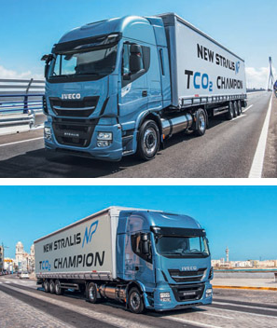
Alternative fuels: Natural gas
LNG = Liquefied Natural Gas
Volume is reduced by cooling to -162°C → LNG requires 600 times less space than natural gas
Fields of application:
  Inland navigation (liquid)
  Trucks (liquid)
  Industrial processes (gaseous)
Advantages:
  Up to 1600km range by truck
  Lower emissions compared to diesel:
  -96% particulate matter, -25% CO₂ , -70% NO_{x}
  Less noise: -5 dB = 1/3 quieter
  Lower operating costs due to lower tax, amortisation of higher acquisition costs within 3 years
Source: IVECO 2017
Notes:
Natural gas is used as an alternative fuel for motor vehicles in compressed natural gas (CNG) and liquefied natural gas (LNG). CNG compresses natural gas to approx. 200 bar in order to be able to carry a sufficient amount of energy in a reasonable volume in the vehicle (1 kg CNG corresponds to 1.3 litres of diesel or 1.5 litres of petrol). LNG or liquefied natural gas is natural gas that is cooled to at least -162°C and thus takes up 600 times less space than unprocessed natural gas. Due to these properties, LNG is considered an alternative to conventional fuels for long-distance transport. LNG can also be used for industrial processes in gas form in addition to its use as fuel for inland waterway vessels and trucks.
Natural gas-powered trucks such as the IVECO Stralis LNG have several advantages over conventional diesel trucks. The range can be increased from 570 km (two compressed natural gas (CNG) tanks) to 1030 km (one CNG tank, one LNG tank) and even up to 1600 km (2 LNG tanks) according to the manufacturer's specifications. Due to the lower engine volume, natural gas-powered trucks are also suitable for night and inner city driving. Comparative values show that significant emission reductions could be achieved by natural gas-powered trucks. The emission values of the IVECO Cursor 8 natural gas engine, for example, are -70% NOx , -96% particulate matter (PM), -90% NMHC, -88% methane and -25% CO2 in comparison with Euro VI limits..
The purchase costs of a natural gas truck are currently almost 30% higher than the purchase price of a conventional diesel truck. Depending on the EU state, the purchase of a natural gas truck is eligible for different levels of government subsidies. In Germany, the purchase is subsidised with 12,000 Euro per vehicle. In addition, the vehicles are exempt from tolls for 2 years and there are tax concessions. In Austria, a comparable subsidy package has not yet been implemented despite repeated demands by the Austrian Federal Economic Chamber. In addition to the subsidies, the reduced fuel consumption of just under 18% contributes significantly to the vehicle's rapid payback. According to practical experience, the higher acquisition costs amortise at 14,000-15,000 km per month within 3 years.
Source:
OMV AG (2019): CNG for passenger cars and commercial vehicles. Available online at https://www.omv.com/en/cng, checked on 7/5/2019.
Aymelek, M.; Boulougouris, E.; Turan, O.; Konovessis, D. (2014): Challenges and opportunities for LNG as a ship fuel source and an application to bunkering network optimisation. In Carlos Soares, T. Santos (Eds.): Maritime Technology and Engineering, vol. 88: CRC Press, pp. 767–776.
IVECO (2018): New Stralis NP. Available online at https://www.iveco.com/Common/Documents/Brochures/new_stralisNP.pdf.
DVGW (2019): Mobility with gas and LNG - climate-friendly fuels. Available online at https://www.dvgw.de/english-pages/topics/dvgws-research-and-development-topics/mobility-with-gas-and-lng/, checked on 7/17/2019.
Rathmann, Matthias (2018): Erdgas rechnet sich. Spediteure prüfen Einsatz von LNG. Available online at https://www.eurotransport.de/artikel/erdgas-rechnet-sich-spediteure-pruefen-einsatz-von-lng-10486265.html.
Proissl, Anneliese (2019): Erdgas-Lkw: Umweltschonend, aber unbeliebt beim Staat. Available online at https://www.trend.at/branchen/auto-mobilitaet/erdgas-lkw-umweltschonend-staat-10597689.
Picture source:
IVECO (2017): Der neue Stralis NP. URL: https://www.iveco.com/austria/neufahrzeuge/pages/new-stralis-np-gas-truck.aspx [01.07.2019]

Slide 13
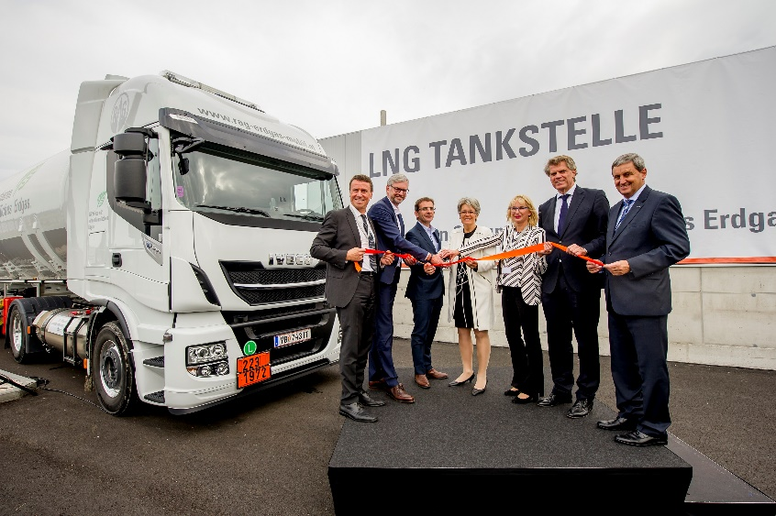
Challenge of LNG: Infrastructure
Filling station infrastructure in Europe at approx. 200 LNG filling stations, but hardly in the landlocked countries along the Danube
CNG (Compressed Natural Gas) as a tempory solution:
  Approx. 3.600 CNG filling stations throughout Europe
  Usable by combination drive
Austria’s first LNG filling station – Ennshafen (Opening September 2017)
  Centrally located on the route from the ports of Rotterdam, Bremen and Hamburg towards Bratislava, Budapest and Bucharest
  LNG processing and supply by domestic companies
  Capacity: 10 to 15 trucks daily
  Second filling station opened in Graz (April 2019)
  Further LNG filling stations planned in Tyrol, Upper Austria and Vienna
Source: Business Upper Austria – OÖ Wirtschaftsagentur GmbH 2017,
© Karin Lohberger
Tank combination | Range
2 CNG Tanks | 570 km
1 CNG Tank, 1 LNG Tank | 1.030 km
2 LNG Tanks | 1.600 km
Source: IVECO 2018
Notes:
A well-developed filling station network is essential for the use of natural gas trucks in long-distance transport. Currently there are approx. 200 LNG filling stations and approx. 3600 CNG filling stations in Europe. There are currently only 2 LNG filling stations in Austria. The companies RAG, Ennshafen OÖ GmbH and IVECO Austria opened Austria's first filling station for LNG (Liquefied Natural Gas) on 26 September 2017 as part of the LNG Future Forum in Ennshafen, Upper Austria. The capacities currently amount to 10 to 15 trucks daily. The second filling station was opened in Graz in April 2019. Vgl. NGVA Europe 2019.
Vgl. Business Upper Austria - OÖ Wirtschaftsagentur GmbH 2017.
Sources:
NGVA Europe (2019): Stations map. Available online at https://www.ngva.eu/stations-map/, checked on 7/1/2019.
Business Upper Austria - OÖ Wirtschaftsagentur GmbH (2017): Erste Flüssigerdgas-Tankstelle in Österreich eröffnet. Available online at https://www.ooe2020.at/rechte-navigation/news-presse/detail/news/erste-fluessigerdgas-tankstelle-in-oesterreich-eroeff/, checked on 7/1/2019.
STANDARD Verlagsgesellschaft m. b.H. (2019): Bei Flüssiggas steht Österreich auf der Bremse – noch. Available online at https://derstandard.at/2000102771169/Bei-Fluessiggas-steht-Oesterreich-auf-der-Bremse-noch, checked on 7/1/2019.
Picture source:
Business Upper Austria – OÖ Wirtschaftsagentur GmbH (2017): Erste Flüssigerdgas-Tankstelle in Österreich eröffnet. URL: https://www.ooe2020.at/rechte-navigation/news-presse/detail/news/erste-fluessigerdgas-tankstelle-in-oesterreich-eroeff/ [21.05.2019]

Slide 14
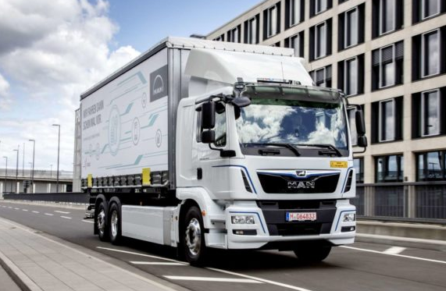
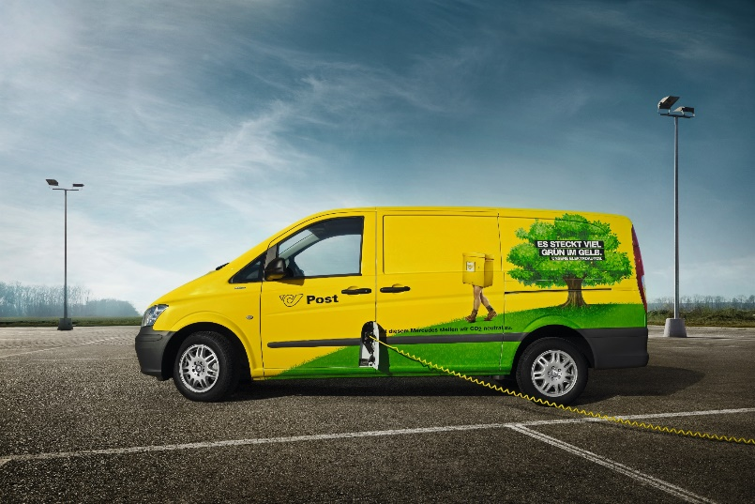
E-Mobility (Last Mile)
MAN: Research project MegaWATT
  E-trucks for urban transport
  180 km range
  Test area: Vienna, Graz, Salzburg
  Goal: CO2-free urban logistics by 2030 in larger conurbations
Austrian post
  Austria’s largest electric fleet: 1600 single and multi-track electric vehicles
  Goal: 100% CO2-free delivery of letters and parcels
    Already implemented in Vienna
Source: © MAN
Source: © W. Streitfelder for Österreichische Post AG
Notes:
Freight transport is responsible for 50% of CO2 emissions in urban road traffic. Transports by small trucks have doubled since 1990 and have thus risen to 2.3 billion tonne-kilometres. A further increase is to be expected due to the increasing online trade. E-mobility in short-distance transport to reduce pollutant and noise pollution.
As part of the "MegaWATT" research project, truck manufacturer MAN has launched a pilot project to test electric trucks (26-tonne electric vehicles) in urban areas. 9 electric trucks with a range of 180 km are currently being tested in the urban areas of Vienna, Graz and Salzburg. The aim of the "MegaWATT" research project, funded by the Climate and Energy Fund and led by the University of Natural Resources and Applied Life Sciences (BOKU), is CO2-free urban logistics by 2030 in larger conurbations.
Austrian Post has been relying on electromobility for some time and now has the largest electric fleet in Austria with 1600 single and multi-lane electric vehicles. The goal is a 100% CO2-free delivery of letters and parcels. This goal has already been achieved in Vienna.
Sources:
VCÖ (2016): Der urbane Gütertransport der Zukunft ist emissionsfrei. Online verfügbar unter https://www.vcoe.at/files/vcoe/uploads/News/VCOe-Factsheets/2016-02%20-%20Der%20urbane%20Guetertransport%20der%20Zukunft%20ist%20emissionsfrei/VC%C3%96-Factsheet%20Urbaner%20G%C3%BCtertransport.pdf, [01.07.2019]
BMVIT (2018): MegaWATT rollt an: Die ersten neun Elektro-Trucks ausgeliefert. Online verfügbar unter https://infothek.bmvit.gv.at/man-in-steyr-praesentation-uebergabe-elektro-trucks/, [01.07.2019]
MAN Truck & Bus AG (2019): Electric trucks in action – MAN and CNL begin practical testing | MAN Truck Germany. Available online at https://www.truck.man.eu/de/en/man-world/man-in-germany/press-and-media/Electric-trucks-in-action-_-MAN-and-CNL-begin-practical-testing-343552.html, updated on 7/28/2019, checked on 7/29/2019.
Österreichische Post AG (2019): E-Mobilität. Online verfügbar unter https://www.post.at/co2neutral/e_mobilitaet.php, [01.07.2019]
Picture source:
MAN (2018). https://infothek.bmvit.gv.at/man-in-steyr-praesentation-uebergabe-elektro-trucks/ [01.07.2019]
Post AG (2018). URL: https://www.post.at/footer_ueber_uns_multimedia_archiv_bilder.php#collapse-5d19f2c47f94c-3 [01.07.2019]

Slide 15

Optimisation of existing means of transport
Quiz
Which optimisations of existing means of transport do you know?
Source: pixabay
Notes:
Which optimisations of existing modes of transport do you know?
Automated driving: Platooning, autonomous cargo ships, high-speed freight train
Alternative fuels: natural gas (LNG and CNG), electric mobility
Picture source:
https://pixabay.com/de/illustrations/fragezeichen-haufen-frage-marke-1495858/

Slide 16
Agenda
Future Trends in Freight Transport
Why we need alternatives in freight transport
Innovative transport concepts
Visionary means of transport
Optimisation of existing means of transport

Slide 17
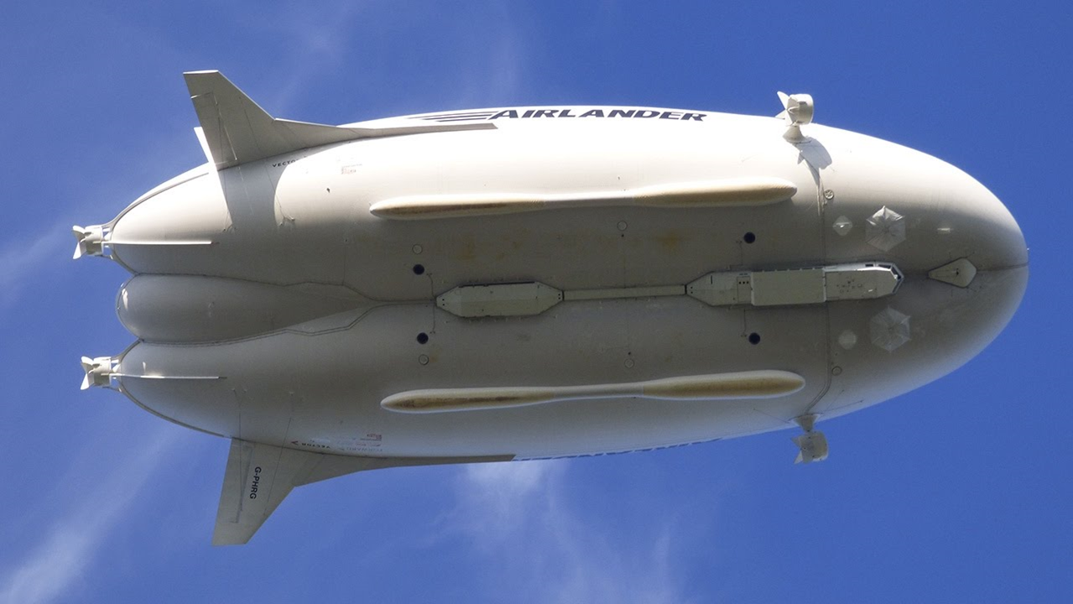
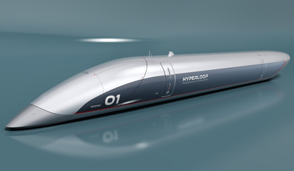
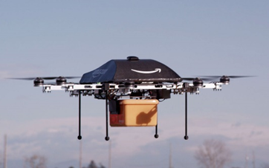
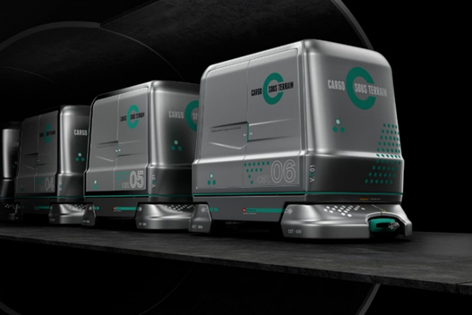
Visionary means of transport
Transport airship
Hyperloop
Visionary means of transport
Drones
Cargo Sous Terrain
Notes:
Picture source:
Amazon.com. https://www.amazon.com/Amazon-Prime-Air/b?ie=UTF8&node=8037720011 [01.07.2019]
CST AG. https://www.cst.ch/wp-content/uploads/2019/04/Cargo-sous-terrain_Fahrzeug_02.jpg [01.07.2019]
Hybrid Air Vehicles. https://www.hybridairvehicles.com/our-aircraft/airlander-10/ [01.07.2019]
Hyperloop TT. https://www.dropbox.com/sh/p85hepf1y829aju/AABhhgj3QbFcdAB61hsX-dHda/I.%20Latest%20HyperloopTT%20Assets/Images%20-%20HyperloopTT?dl=0&preview=HyperloopTT+capsule.jpg&subfolder_nav_tracking=1 [01.07.2019]

Slide 18
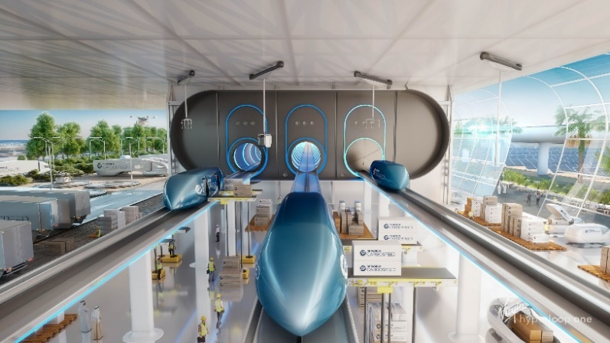
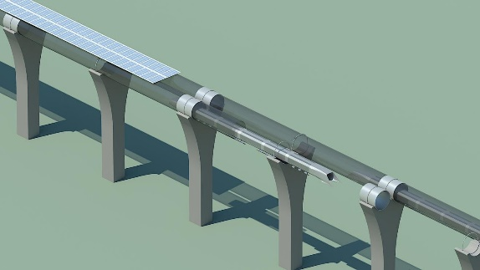
HYPERLOOP – The pneumatic tube system of the future
Founder: Elon Musk (2013)
Transport of vehicles (pods) in tubes with almost vacuum conditions
  Transport speeds of up to 1,220 km/h
  Transport capacity per pod approx. 12 tons
  Different diameters planned (for freight, persons and parcels)
Grid-connected
  Pods can only be moved in the infrastructure provided for this purpose
  Construction of the pipe network on pillars or through tunnels
  Electricity-operated - Energy supply planned through solar panels on the top of the tubes
Source: Virgin Hyperloop one
Source: Hyperloop Alpha White Paper
Notes:
Hyperloop is a new concept, created by Elon Musk (founder of Tesla, PayPal and SpaceX), for the transport of goods and people, often called the fifth mode. The vehicles, so-called pods, move at speeds of up to 1220 km/h through "evacuated tubes". These are tubes in which almost vacuum conditions are created in order to maintain the lowest possible air resistance economically. The pods are driven by electric motors and lifted from the ground by air pressure in order not to cause friction, unlike vehicles on wheels. According to calculations, the transport capacity is about 12 tonnes per pod. The transport capacity was calculated on the basis of the white paper from SpaceX, a mobility concept for hyperloops presented by Elon Musk. However, no official tests have yet been carried out to determine how high the payload may be in order not to exceed certain physical forces (g-forces) and speeds. There is also no information on the size for the different versions for three versions (freight, persons and packages). A feasibility study by NASA, for example, points to a much larger diameter of the tubes in order to achieve the specified speed of max. 1220 km/h.
Sources:
SpaceX (2013): Hyperloop Alpha. Available online at https://www.spacex.com/sites/spacex/files/hyperloop_alpha-20130812.pdf, checked on 7/1/2019.
Werner, Max; Eissing, Klaus; Langton, Sebastian (2016): Shared Value Potential of Transporting Cargo via Hyperloop. In Front. Built Environ. 2, p. 11. DOI: 10.3389/fbuil.2016.00017.
Taylor, Catherine L.; Hyde, David J.; Barr, Lawrence C. (2016): Hyperloop Commercial Feasibility Analysis : High Level Overview. With assistance of John A. Volpe National Transportation Systems Center (U.S.). Available online at https://rosap.ntl.bts.gov/view/dot/12308.
Picture sources:
Virgin Hyperloop one (2019). URL: https://www.dropbox.com/sh/6pejtkr49pljjyb/AAD5kjKUgJAvDIf1jhAo_wNha?dl=0&preview=Virgin_Hyperloop_One_2-4.jpg [01.07.2019]
http://www.spacex.com/sites/spacex/files/hyperloop_alpha-20130812.pdf, [21.05.2019]

Slide 19
HYPERLOOP – Pros & Cons
Pros
Environmentally friendly: Energy from solar power
Relief for conventional modes of transport
High transport speed
High frequency: departure every 30 sec - 2 min or on demand
Autonomous operation
Permanent operation possible: no night driving bans, no traffic jams, no accidents
Low transport costs: between 1.9 Cent and 9.8 Cent per tkm
Cons
High investment costs for new infrastructure
Costs strongly dependent on topographical structure:
  Tunnels are necessary for gradients above 6 % → Additional costs
  Obstacles bypassed by curves → Additional costs
Power generation with solar panels not suitable for all geographical locations
Inflexible in terms of area coverage:
  Pre- and onward carriage are necessary
Notes:
Due to the fully autonomous operation, transport and arrival times can be precisely determined, thus ensuring optimised intermodal transport without waiting times. Transport and arrival times can also be calculated and passed on in real time in the event of delays in the lead time. Since the concept provides for high-speed transport from A to B, it is not possible to deliver to the end customer or to offer a dense network due to characteristics such as speed or infrastructure. Therefore, pre-carriage and onward carriage are necessary to collect goods from the consignor and bring them to the hyperloop facility and, furthermore, from the hyperloop destination to the consignee (comparable to rail transport).
Hyperloops have the potential to relieve the burden on conventional modes of transport , especially as a substitute for air transport for small, urgent valuable goods. The hyperloop is also seen as an alternative for overseas transport and has a certain potential. On the other hand, however, there are the high costs for new infrastructures. These are strongly dependent on the topographical structure. Gradients of over 6% require the construction of costly tunnels. Avoiding obstacles by means of curves also leads to considerable additional costs. The SpaceX White Paper estimates construction costs at around €9.5 million per kilometre, with a further €27 million being added if a tunnel is required. This value depends on many factors, such as land acquisition costs, stability (storms, earthquakes, etc.), obstacles (bridges, waters, etc.) and of course the tunnel kilometres required. The situation is similar with the use of solar panels along the hyperloop line, which would guarantee an environmentally friendly energy supply for the hyperloop. An economically sensible use of solar panels, however, is strongly dependent on the geographical location and therefore not suitable everywhere.
Sources:
SpaceX (2013): Hyperloop Alpha. Online verfügbar unter https://www.spacex.com/sites/spacex/files/hyperloop_alpha-20130812.pdf, [01.07.2019]
Werner, Max; Eissing, Klaus; Langton, Sebastian (2016): Shared Value Potential of Transporting Cargo via Hyperloop. In: Front. Built Environ. 2, S. 11. DOI: 10.3389/fbuil.2016.00017 [01.07.2019]
Taylor, Catherine L.; Hyde, David J.; Barr, Lawrence C. (2016): Hyperloop Commercial Feasibility Analysis : High Level Overview. Unter Mitarbeit von John A. Volpe National Transportation Systems Center (U.S.). Online verfügbar unter https://rosap.ntl.bts.gov/view/dot/12308. [01.07.2019]

Slide 20
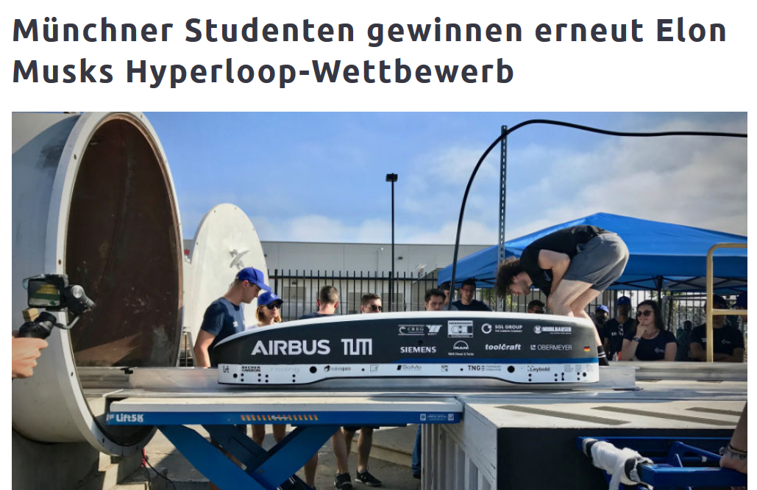
HYPERLOOP – Field of application and status quo
Field of application
(passenger transport)
Trend towards goods transport
  Different sizes
  Own size for parcel transport considered
Status Quo
10 economically most attractive routes determined by Global Challenge
TU Munich winner for the third time with the fastest podium
Test tracks already in operation
  Virgin Hyperloop One - Desert of Nevada Most Developed
Cost of LA-San Francisco (550 km) € 6 billion to 16 billion.
•
Munich students again win Elon Musk's Hyperloop Competition
Source: TUM Hyperloop 2017
Notes:
The basic idea of the hyperloop is passenger transport, since individual transport is much more time-sensitive than freight transport. Urban agglomerations ought to be connected and merged to form "megacities. Virgin Hyperloop One has (presumably due to the danger associated with the extensive testing of prototypes of new technology) also developed different sized freight versions of the hyperloop to relieve congested roads to and from open sea ports.
Elon Musk published a white paper on the concept and calculations of the hyperloop in 2013 and launched a global challenge on the best pod technology. The WARR team of the TU Munich has managed to win the competition in the three challenges so far. Virgin Hyperloop One launched a global competition in creating the survey of the most economically appealing routes. Of 2600 registrations, 10 routes are currently in the finals.
Sources:
SpaceX (2013): Hyperloop Alpha. Available online at https://www.spacex.com/sites/spacex/files/hyperloop_alpha-20130812.pdf, checked on 7/1/2019.
Hawkins, Andrew J. (2018): WARR Hyperloop pod hits 284 mph to win SpaceX competition. Available online at https://www.theverge.com/2018/7/22/17601280/warr-hyperloop-pod-competition-spacex-elon-musk, checked on 7/1/2019.
DP World (2019): DP World Cargospeed. Available online at https://www.dpworld.com/smart-trade/dp-world-cargospeed, checked on 7/1/2019.
Virgin Hyperloop One (2019): Hyperloop One Global Challenge. Available online at https://hyperloop-one.com/global-challenge, updated on 6/26/2019, checked on 7/1/2019.
Picture source:
https://www.flickr.com/photos/148755431@N04/36010454304/
Video source::
The Economist (2017): Elon Musk's hyperloop could revolutionise public transport. URL: https://www.youtube.com/watch?v=lWo6LscqSGg [14.06.2019]
Virgin Hyperloop One (2018): Building DevLoop. URL: https://www.youtube.com/watch?v=QLFQlraM5tg [14.06.2019]

Slide 21
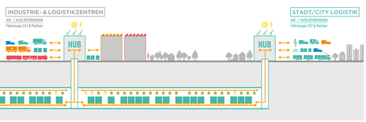
CARGO SOUS TERRAIN – Underground tunnels for goods
Sustainable, automated total logistics system consisting of an underground tunnel system
Urban agglomerations are linked with production and logistics locations
Transport of pallets/containers for parcels, piece goods, bulk goods and their intermediate storage
City Logistics Solution → Last Mile Problem
•
Source: Cargo sous terrain AG
Notes:
Cargo Sous Terrain is a Swiss concept for a sustainable, automated overall logistics system that connects conurbations with production and logistics locations in an underground tunnel system and is to be operated 100% by renewable energies. The plan provides for the transport of pallets and containers for parcels, piece goods, bulk goods and their intermediate storage and a city logistics solution for distribution on the Last Mile. The transport takes place on multi-lane lines by means of fully autonomous, electric vehicles on wheels, which can change lanes flexibly and move on to their destination in a bundled form. This happens at 30 km/h 24/7. The vehicles are to provide space for two Euro pallets and transport all goods that can be provided on pallets. Smaller transports are carried out in the same system by means of overhead conveyors with double speed (60 km/h) in both directions. In the middle lanes, the shipments are bundled according to destination. This results in advantages for the associated city logistics solution, as the deliveries are also loaded in bundles and cause less overall traffic in the city, which results in better effects in terms of noise, CO2 emissions and other emissions. In addition, returns, recycled material, etc. in the opposite direction are also planned into the route guidance in order to make optimum use of the routes. This reduces the volume of freight traffic in densely populated regions and thus also congestion.
A 70 km test section between Härkingen/Niederbipp and Zurich is planned, followed by an extension of the tunnel system from Lake Constance to Lake Geneva with extensions to Basel, Lucerne and Thun. The aim is to connect conurbations with production and logistics locations.
Source:
Cargo sous terrain AG (2019): Was ist CST. Available online at https://www.cst.ch/was-ist-cst/, checked on 7/1/2019.
Picture source:
Cargo sous terrain AG (2019) URL: https://www.cst.ch/medienbereich/ [01.07.2019]
Video source:
Cargo sous terrain (2016): Cargo sous terrain – Erklärung System. URL: https://www.youtube.com/watch?v=r11X-zMF_pc [01.07.2019]

Slide 22

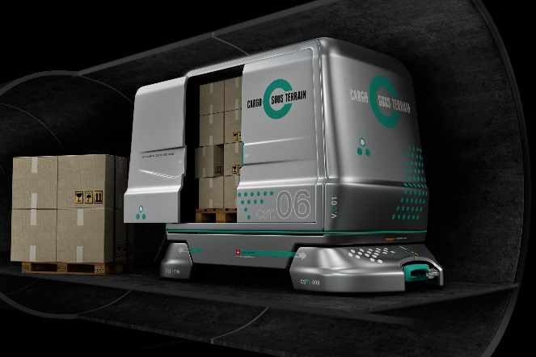
Characteristics of the ‚goods subway‘ system
Powered by electricity from renewable energies
Fully autonomous underground transport by means of electric vehicles on wheels and overhead conveyors
Transport speed:
  Electric vehicles: 30 km/h (capacity of 2 Euro pallets per vehicle)
  Overhead conveyor: 60 km/h (smaller packages)
Underground road network with several lanes on which the vehicles can change flexibly and bundle transports
Connection of logistics centres and cities in Switzerland
Associated City Logistics Concept
Source: Cargo sous terrain AG
Source: Cargo sous terrain AG
Notes:
Cargo Sous Terrain is a Swiss concept for a sustainable, automated overall logistics system that connects conurbations with production and logistics locations in an underground tunnel system and is to be operated 100% by renewable energies. The plan provides for the transport of pallets and containers for parcels, piece goods, bulk goods and their intermediate storage and a city logistics solution for distribution on the Last Mile. The transport takes place on multi-lane lines by means of fully autonomous, electric vehicles on wheels, which can change lanes flexibly and move on to their destination in a bundled form. This happens at 30 km/h 24/7. The vehicles are to provide space for two Euro pallets and transport all goods that can be provided on pallets. Smaller transports are carried out in the same system by means of overhead conveyors with double speed (60 km/h) in both directions. In the middle lanes, the shipments are bundled according to destination. This results in advantages for the associated city logistics solution, as the deliveries are also loaded in bundles and cause less overall traffic in the city, which results in better effects in terms of noise, CO2 emissions and other emissions. In addition, returns, recycled material, etc. in the opposite direction are also planned into the route guidance in order to make optimum use of the routes. This reduces the volume of freight traffic in densely populated regions and thus also congestion.
A 70 km test section between Härkingen/Niederbipp and Zurich is planned, followed by an extension of the tunnel system from Lake Constance to Lake Geneva with extensions to Basel, Lucerne and Thun. The aim is to connect conurbations with production and logistics locations.
Source:
Cargo sous terrain AG (2019): Was ist CST. Available online at https://www.cst.ch/was-ist-cst/, checked on 7/1/2019.
Picture source:
Cargo sous terrain AG (2019) URL: https://www.cst.ch/medienbereich/ [01.07.2019]

Slide 23
CARGO SOUS TERRAIN – Pros & Cons
Pros
Environmentally friendly
Relief of the roads (especially in the cities) by automatic bundling and route optimization of the freights
Better productivity per unit area thanks to the tunnel solution
Autonomous transport
24/7 in use
  No night driving bans, no traffic jams, no accidents
Cons
Linked to the route network
The construction of the infrastructure is very costly due to the underground route.
Different soil conditions in different regions can make it difficult to build the tunnel
Costs of approximately CHF 3.55 billion (EUR 3.05 billion)
Despite the City Logistics concept in delivery, an individual lead time is necessary
Notes:
The advantages of CST promise efficient, sustainable and timely delivery of goods. Due to the autonomous transport and the possibility to transport goods 24 hours a day, shipments can be handled reliably, quickly and permanently. The Swiss government has drawn up a special law to facilitate tunnel construction and not to be dependent on different legal situations in the participating cantons. This is to enter into force after submission of the plan for the first section of the route. In addition, the underground tunnelling results in better productivity per unit area for Switzerland.
Since the routing takes place exclusively in tunnels, spatial flexibility is limited to the route network and the system can therefore only carry out transports between the specified nodes. A corresponding city logistics concept is planned, which will bundle the goods from the destination hub into the cities and pursue optimised transport routes, in which the return transports are already taken into account. The project is being privately financed and is estimated to cost CHF 3.55 billion. The Swiss Post, the grocery chains Migros and Coop, SAP, the Swiss Federal Railways, Swisscom and many other Swiss and international companies such as insurance companies, banks and Virgin Hyperloop One are involved in this mammoth project. An initial financing of 100 million Euro has already been approved by the investors
Sources:
Maibach, Markus; Ickert, Lutz; Sutter, Daniel (2016): Volkswirtschaftliche Aspekte und Auswirkungen des Projekts Cargo Sous Terrain (CST). INFRAS. Available online at https://www.infras.ch/media/filer_public/0f/cd/0fcdaed1-1bc3-42a5-a7f1-22a3481b2cac/cst_infras_schlussbericht-23092016.pdf, checked on 7/1/2019.
Cargo sous terrain AG (2019): Was ist CST. Available online at https://www.cst.ch/was-ist-cst/, checked on 7/1/2019.

Slide 24
CARGO SOUS TERRAIN – Field of application and status quo
Field of application
Transport and intermediate storage of pallets and containers for
  parcels
  piece goods
  bulk material
  Fresh and chilled goods
  Not for dangerous goods, heavy and low-value bulk goods
City logistics solution included
24/7 use
Status Quo
Private consortium
Support from the Swiss government through a special law
Over CHF 100 million already acquired
2030 first track finished (70 km)
  327 million TKM Potential for first stage
Support for major shareholders:
  Virgin Hyperloop One, SAP, Migros, Coop, Swiss Post, SBB Cargo, Swisscom, Zurich Cantonal Bank, Rhenus Logistics, BKW, etc.
Notes:
The advantages of CST promise efficient, sustainable and timely delivery of goods. Due to the autonomous transport and the possibility to transport goods 24 hours a day, shipments can be handled reliably, quickly and permanently. The Swiss government has drawn up a special law to facilitate tunnel construction and not to be dependent on different legal situations in the participating cantons. This is to enter into force after submission of the plan for the first section of the route. In addition, the underground tunnelling results in better productivity per unit area for Switzerland.
Since the routing takes place exclusively in tunnels, spatial flexibility is limited to the route network and the system can therefore only carry out transports between the specified nodes. A corresponding city logistics concept is planned, which will bundle the goods from the destination hub into the cities and pursue optimised transport routes, in which the return transports are already taken into account. The project is being privately financed and is estimated to cost CHF 3.55 billion. The Swiss Post, the grocery chains Migros and Coop, SAP, the Swiss Federal Railways, Swisscom and many other Swiss and international companies such as insurance companies, banks and Virgin Hyperloop One are involved in this mammoth project. An initial financing of 100 million Euro has already been approved by the investors
Sources:
Maibach, Markus; Ickert, Lutz; Sutter, Daniel (2016): Volkswirtschaftliche Aspekte und Auswirkungen des Projekts Cargo Sous Terrain (CST). INFRAS. Available online at https://www.infras.ch/media/filer_public/0f/cd/0fcdaed1-1bc3-42a5-a7f1-22a3481b2cac/cst_infras_schlussbericht-23092016.pdf, checked on 7/1/2019.
Cargo sous terrain AG (2019): Was ist CST. Available online at https://www.cst.ch/was-ist-cst/, checked on 7/1/2019.

Slide 25

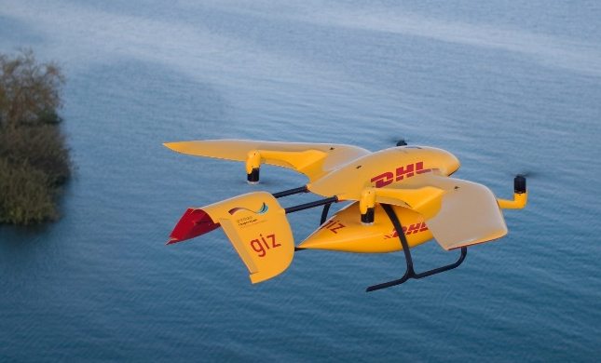
DRONES – Parcel service from above
UAV (unmanned aerial vehicles)
A variety of drones with respect to:
  Size
    2 kg own weight up to 275 kg payload weight
  Drive technology
    Battery-powered; power generation by solar cells; combustion engines;...
  Field of application
    Camera drones for surveillance; fully autonomous drones for intralogistics; working drones in the agricultural sector;...
    Oversized large drone with a payload weight of 90 tons currently being developed by Canadian company "NATILUS
Source: Amazon
•
•
Source: Deutsche Post
Notes:
"Unmanned Aerial Vehicles" (UAV), popularly referred to as "drones", are now available in a wide variety of configurations in terms of size, propulsion technology, application area, etc. Beginning at a total weight of less than two kg up to a 275 kg payload weight, from battery operated to energy generation to solar cells to combustion engines, and from camera drones for surveillance to fully autonomous drones for intralogistics to working drones in the agricultural sector, the possibilities which drones are supposed to offer have very few limitations. Even an oversized drone with a payload weight of 90 tonnes, designed by the Canadian company "NATILUS" for intercontinental flights, is currently in its development phase.
In this teaching aid package only drones for commercial use, which serve as means of transport, are considered and no models for private use or military drones. The characteristics of parcel drones are presented, which are already being tested by various CEP (courier, express, parcel) service providers for the delivery of parcels on the Last Mile. Amazon, for example, is currently testing its Prime Air drone with which an Amazon Fire TV Stick has already been delivered as a demo within 13 minutes of ordering. DHL is also experimenting with drones and has successfully supplied remote locations in the Bavarian Reit im Winkl with its "Paketkopter 3.0" and an automated parcel station ("SkyPort"). A total of 130 autonomous loading and unloading operations have been carried out in this project. UPS is testing the delivery of packages via drones starting from the roof of a delivery vehicle. All these companies are trying to take advantage of the flexibility and coverage of this technology, each with a different approach.
Sources:
Amazon.com (2019): Amazon Prime Air. Available online at https://www.amazon.com/Amazon-Prime-Air/b?ie=UTF8&node=8037720011, checked on 7/1/2019.
Deutsche Post AG (2019): DHL Paketkopter. Available online at https://www.dpdhl.com/de/presse/specials/dhl-paketkopter.html, updated on 7/1/2019, checked on 7/1/2019.
UPS (2017): UPS Tests Residential Delivery Via Drone Launched From atop Package Car. Available online at https://pressroom.ups.com/pressroom/ContentDetailsViewer.page?ConceptType=PressReleases&id=1487687844847-162, checked on 7/1/2019.
Pictures sources:
Amazon.com (2019): Amazon Prime Air. Online verfügbar unter https://www.amazon.com/Amazon-Prime-Air/b?ie=UTF8&node=8037720011 [01.07.2019]
Deutsche Post (n.d.). URL: https://www.dpdhl.com/content/dam/dpdhl/de/media-center/media-relations/images/2018/dhl-paketkopter-tansania.jpg [14.06.2019]
Videoquellen:
DHL (2016): Logistische Innovation: Der DHL Paketkopter 3.0. URL: https://www.youtube.com/watch?v=5cBEFK70FCU [14.06.2019]

Slide 26
DroneS – Pros & Cons
Pros
Environmentally friendly
Relief of the roads in the cities
Flexible in time
No traffic network required
point-to-point delivery
High potential for urgent transports (e.g. medicines, food, intralogistics, etc.)
Low transport costs of approx. € 1 per delivery (payload 2 kg; distance 12 km)
Cons
Short range (Amazon drone: approx. 24 km)
Weather dependency:
  Transports at wind speeds above 40 km/h cannot yet be carried out
Due to the legal situation, an autonomous flight is currently not permitted without special permits.
Flight bans in densely populated areas do not currently make home delivery possible in urban areas
Notes:
The drones considered in the CEP sector can be used very flexibly due to their fast availability and their independence from infrastructure. In addition, in the case of electrically operated drones, they cause no emissions. The range of drones strongly depends on their construction (body, engine, etc.) and the weight they are loaded with. The same applies to weather dependency: the stronger the drone, the lower the external influences.
The legal situation in Austria does not currently permit autonomous flights by drones, special permits must be obtained for tests. Drone flights must at least be monitored in order to enable a pilot to intervene in dangerous situations. However, solutions are already being worked on to increase security, such as parachutes that are triggered in the event of a system failure or redundant system protection, encryption against hacking attacks, etc.
Sources:
D'Andrea, Raffaello (2014): Guest Editorial Can Drones Deliver? In: IEEE Trans. Automat. Sci. Eng. 11 (3), S. 647–648. DOI: 10.1109/TASE.2014.2326952. [01.07.2019]
RIS (2019): Luftfahrtgesetz, Fassung vom 01.07.2019. Available online at https://www.ris.bka.gv.at/GeltendeFassung.wxe?Abfrage=Bundesnormen&Gesetzesnummer=10011306, checked on 7/1/2019.

Slide 27
DroneS – Field of application and status quo
Field of application
Small transports over short distances and/or destinations that are difficult to access (e.g. managed alpine huts, medicines)
  86% of Amazon's deliveries weigh less than 2.5 kg and could be shipped by drone (small / light category) (distance max. 24 km)
Intralogistics (legally unproblematic)
Status Quo
Technology very mature
Use outside the company premises due to lack of legal coverage currently hardly possible
  Special permits required for tests
Application in intralogistics, agriculture, surveying, media and security services
Notes:
In different areas, where legislation is not as strict as in Central Europe, drones are already being used to supply hospitals with medicines and other express transports. Since October 2016, the Californian company Zipline has been supplying blood to 21 hospitals in Rwanda and Tanzania from a distribution centre using special drones with a range of up to 150 kilometres (round-trip). This reduces the supply time from four hours (due to the very poor infrastructure) to 15 minutes. Drones are also increasingly being used in agriculture. Drones can use thermal imaging cameras to detect fawns before mowing, as well as infrared cameras to create a vegetation index and pest control with spray agents. Intralogistics is also increasingly concerned with the use of drones. For example, the InventAIRy research project is aiming for an automatic inventory by means of autonomous drones.
Sources:
Zipline (2019): Our Impact. Available online at https://flyzipline.com/impact/, updated on 5/27/2019, checked on 7/1/2019.
Polly, Stefan (2018): Drohnen in der Landwirtschaft: Was die kleinen Überflieger leisten | Landwirtschaftskammer - Technik. Available online at https://noe.lko.at/drohnen-in-der-landwirtschaft-was-die-kleinen-%C3%BCberflieger-leisten+2500+2800345, checked on 7/1/2019.

Slide 28
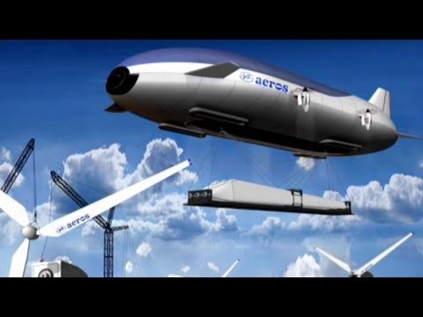
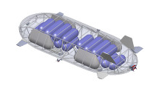
Transport airships
Different concepts will be tested
The controllability of a helium-air ratio allows the load of the cargo to be balanced during loading and unloading
Similar to the system of a submarine
Up to 280 meters long, 108 meters wide and 66 meters high
Vertical take-off & landing manoeuvre
Air cushion for landing
Source: Aeroscraft©
Source: Aeroscraft©
Notes:
To get freight into the air and to relieve the transport modes on land is also the aim of transport airships or cargo zeppelins. For some years now, work has been underway on various concepts to this end. The controllability of a helium-air ratio allows the load of the cargo to be balanced during loading and unloading and makes compensation via external ballast superfluous. This system can be compared to that of a submarine, which absorbs water to sink and segregates to ascend. This technology also enables vertical take-off and landing manoeuvres and therefore does not require a runway or airport for landing. Due to the enormous size of the transport ships, a large landing area is required for full landing and maintenance. The transport ships use air cushions for landing in order to be able to land on uneven terrain. By controlling the air in the air cushions, the transport ship can be moved on the ground similar to a hovercraft and the intake pressure of the air cushions can be regulated to keep the transport ship safely on the ground.
The company Aeros is currently planning the construction of transport airships up to 280 metres long, 108 metres wide and 66 metres high. The loading capacity of the largest model is to be 500 tonnes. Due to their high cargo capacities, transport airships are predestined for high & heavy goods. Components of pipelines or wind turbines, expedition goods or goods for disaster operations (military equipment, humanitarian operations) can be delivered directly to the scene of the disaster.
Sources:
Aeros (2019a): Applications. Available online at http://aeroscraft.com/applications/4580412718, updated on 6/7/2019, checked on 7/2/2019.
Aeros (2019b): Fleet. Available online at http://aeroscraft.com/fleet-copy/4580475518, updated on 6/7/2019, checked on 7/2/2019.
Aeros (2019c): Key technology. Available online at http://aeroscraft.com/technology-copy/4580412172, updated on 6/7/2019, checked on 7/2/2019.
Picture sources:
Aeros (2019a): Applications. Online verfügbar unter http://aeroscraft.com/applications/4580412718, zuletzt aktualisiert am 07.06.2019, zuletzt geprüft am 02.07.2019.
Aeros (2019c): Key technology. Online verfügbar unter http://aeroscraft.com/technology-copy/4580412172, zuletzt aktualisiert am 07.06.2019, zuletzt geprüft am 02.07.2019.

Slide 29
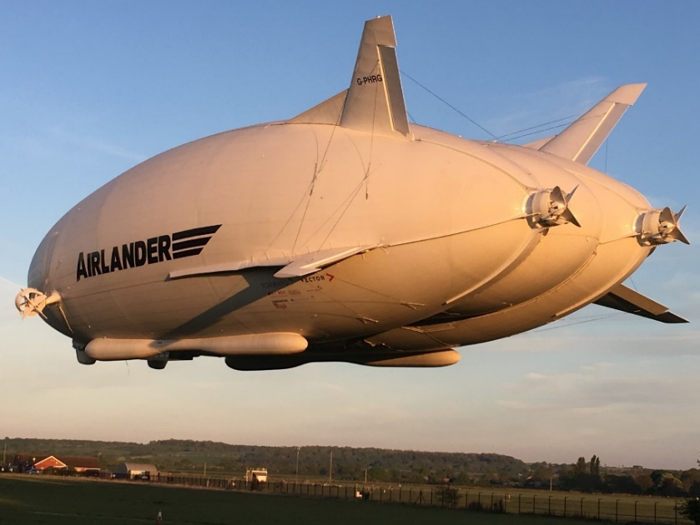
Transport airships – Pros & Cons
Pros
Environmentally friendly
Relief for conventional modes of transport
High transport capacity and large loading volume
  Up to 500 t payload capacity planned; space for six 40" ISO containers
High speeds (up to 220 km/h)
Long range (22,000 km in seven days)
Low transport costs of approx. € 0.5 per tkm (much cheaper than airplane)
No runway or airport necessary
Cons
High investment costs (purchase price approx. € 40 million)
Size of the area required for take-off and landing due to the large dimensions of the zeppelins
Source: Hybrid Air Vehicles
Notes:
Due to the naturally created lift without an engine, emissions are far below those of conventional air transport. The vertical take-off and landing manoeuvres enable point-to-point delivery and thus relieve the burden on conventional modes of transport. Load zeppelins are also much faster than classic ground transport, with this type of transport maximum speeds of up to 220 km/h can be achieved. In the final version a transport airship should be able to carry out intercontinental transports. The longest distance across the Pacific Ocean is 19,000 kilometres, the distance Shanghai – Los Angeles is about 10,400 km. According to a feasibility study, the range should be over 22,000 km which could be covered in seven days. Transport costs are estimated at 0.5 Euro per tonne-kilometre, significantly lower than for conventional air transport (1.5 Euro per tonne-kilometre). On the other hand, however, there are the high investment costs, which are estimated at 33 million Euro (Airlander 10 model from Hybrid Air Vehicles) to approx. 55 million Euro (ML868 model) , depending on the model and load capacity.
Sources:
Rogers, David (2015): Blimps are back: Giant airship goes on sale. Available online at http://www.globalconstructionreview.com/innovation/blimp8s-a8r8e-b6ac8k-gi0a8nt4-0a6i4r2sh08ip/, checked on 7/2/2019.
Hybrid Air Vehicles (2016): Airlander - a new price/speed option. Available online at https://www.aerosociety.com/Assets/Docs/Events/Conferences/2016/809/2.%20Airlander%20-%20A%20New%20Price%20Speed%20Option.pdf, checked on 7/2/2019.
Murray, Tom (2018): Inside the world's largest aircraft, which is set to have glass floors and take wealthy travellers on luxury 3-day expeditions. Business.Insider.Deutschland. Available online at https://www.businessinsider.de/inside-the-worlds-largest-aircraft-airlander-10-wealthy-travelers-on-luxury-3-day-expeditions-2018-7?r=US&IR=T, updated on 7/24/2018, checked on 7/2/2019.
Davies, Alex (2013): This Huge Zeppelin Could Revolutionize The Shipping Industry. Business Insider. Available online at https://www.businessinsider.com/aeroscraft-airship-could-change-avatiation-2013-9?IR=T, updated on 9/9/2013, checked on 7/2/2019.
Picture source:
https://www.hybridairvehicles.com/our-aircraft/airlander-10/

Slide 30
Transport airships – Fields of application and status quo
Fields of application
Up to 500 tons transport capacity in the Zeppelin (approx. 25 trucks)
Remote areas can be reached
High & heavy goods: construction of pipelines, wind turbines, expeditions
Disaster relief operations (military equipment, humanitarian operations)
Status Quo
Positive test flights, but still in much smaller versions than planned in the future
  Currently max. 10 t
  Next step 50 t
No clear legislation on the commercial use of airspace by transport airships
  Airlander 10: British authorities grant approval for commercial use → Planned launch 2020
Cargolifter filed for bankruptcy in 2002 after cost explosion in development
Notes:
Both Aeros and Hybrid Air Vehicles have already performed positive test flights with their models, but still in much smaller versions than planned in the future. The loading capacity is currently 10 tonnes and is to be expanded to 50 tonnes in the next step. However, the fact that airship transport is a volatile market is shown by the fate of Cargolifter, which had to declare bankruptcy in 2002 due to a cost explosion during development. It is still unclear how the legislation on the commercial use of airspace by transport airships will develop in order to ensure smooth international aviation. However, Hybrid Air Vehicles has already received commercial approval from the UK authorities for its Airlander 10 model and intends to launch the transport airship in 2020. Budras 2015.
Sources:
Budras, Corinna (2015): Cargolifter: Hochfliegende Träume. Frankfurter Allgemeine Zeitung GmbH. Available online at https://www.faz.net/aktuell/finanzen/aktien/hochfliegende-traeume-fuehrten-bei-cargolifter-in-die-insolvenz-13963312.html, checked on 7/2/2019.
Pluta, Werner (2019): Luftschiff: Der Airlander wird gebaut. Available online at https://www.golem.de/news/luftschiff-der-airlander-wird-gebaut-1901-138702.html, checked on 7/2/2019.

Slide 31

Visionary means of transport
Quiz
Which visionary means of freight transport do you know?
Source: pixabay
Notes:
Which visionary means of freight transport do you know?
Answer: Hyperloop, drones, cargo airship, Cargo Sous Terrrain
Picture source:
https://pixabay.com/de/illustrations/banner-header-fragezeichen-frage-1090830/

Slide 32
Agenda
Future Trends in Freight Transport
Why we need alternatives in freight transport
Innovative transport concepts
Visionary means of transport
Optimisation of existing means of transport

Slide 33

Digitalisation/ Networking of logistics
  Industry 4.0 as an extension of the Internet of Things
    Social developments such as online trade lead to a growing need for transport
    Increasing automation of logistics processes
    Autonomous, self-organizing logistics → have a significant influence on the transport volume
  Networking with customers and other key players
    In order to cope with the increasing transport volume
    Creation of a basis of trust
    Readiness for data exchange
Source: Pixabay
Notes:
The topic of digitalisation and networking and the associate Industry 4.0 and the Internet of Things trends are currently relevant topics in logistics. The Internet of Things refers to the numerous everyday devices (e.g. automatic heating system with thermostat) that are connected to the Internet and communicate with each other to exchange sensor data. These devices are called "smart" because they are conceded to have a certain amount of intelligence. Logistics 4.0 is an extension of the underlying idea of an Internet of Things. With the digitalisation of society in general and the increasing number of online purchases, the logistics industry is facing more and more new challenges. Accordingly, networking logistics service providers with customers and other relevant players is of great importance in order to cope with the increasing volume of transport. Even if the technical prerequisites are often already fulfilled or can be implemented relatively quickly, it is still necessary to establish a corresponding basis of trust between the key players. Trust is important in order to realise data exchange and to ensure that stakeholders are prepared to share all relevant data with their partners and that they are not misused for their own purposes. Since willingness to exchange data is often not yet given due to a lack of trust, the attitude of the key players must also be positively influenced in the future.
Sources:
Explainity (2016): Internet der Dinge einfach erklärt. Available online at https://www.youtube.com/watch?v=yLZbzbO_7yQ, checked on 7/5/2019.
Heistermann, Frauke; Hompel, Michael ten; Mallée, Torsten (2017): Digitalisierung in der Logistik - Die BVL: Das Logistik-Netzwerk für Fach- und Führungskräfte. BVL - Bundesvereinigung Logistik e.V. Bremen. Available online at https://www.bvl.de/misc/filePush.php?id=35017&name=BVL17+Positionspapier+Digitalisierung+in+der+Logistik, checked on 7/2/2019.
Derndorfer, Anna: Logistik 4.0. Macher Media House GmbH. Available online at https://diemacher.at/1083/logistik-4, checked on 7/2/2019.
Picture source:
Pixabay. URL: https://pixabay.com/de/netzwerke-internet-sozial-3017389/ [14.06.2019]

Slide 34





Innovative transport concepts – An overview
+
+
+
+
+/-
+/-
+
+
Source: Own figure
Notes:
Europe faces the challenge that in many cases only two modes of transport (road and rail) are available, as in many areas inland waterways and the associated waterways are not yet adequately developed or the required infrastructure is not available. As a result, European transport chains often do not have sufficient capacity, as the infrastructure has already reached its maximum capacity, especially in the road sector. Furthermore, the sustainability aspect is increasingly coming to the fore. This means that the optimal use of existing transport resources for freight transport is becoming increasingly important to ensure efficient and cost-effective transport for the future. In order to guarantee an optimal utilisation of the different means of transport and to counteract the emerging challenges, different transport concepts have been developed in the last few years.
The use of different means of transport to exploit the strengths of each transport mode is the idea of multimodality. Intermodality makes it possible to use different modes of transport by transporting products in the same transport unit, thus reducing transhipment costs. The idea of co-modality is to use the means of transport that are most suitable for the different transport routes (depending, for example, on the product). Synchromodality combines the best aspects of previous concepts – standardised transport units across all transport modes, bundling the strengths of different transport modes, avoiding unimodal transport – by adding real-time data to ensure the most efficient transport. The concept of synchronous modality can also be seen as a first step towards the Physical Internet, developed by Canadian Professor Benoit Montreuil (see Slide 36).
Source:
Reis, Vasco (2015): Should we keep on renaming a +35-year-old baby? In: Journal of Transport Geography 46, S. 173–179. DOI: 10.1016/j.jtrangeo.2015.06.019.
Image source:
Own figure

Slide 35
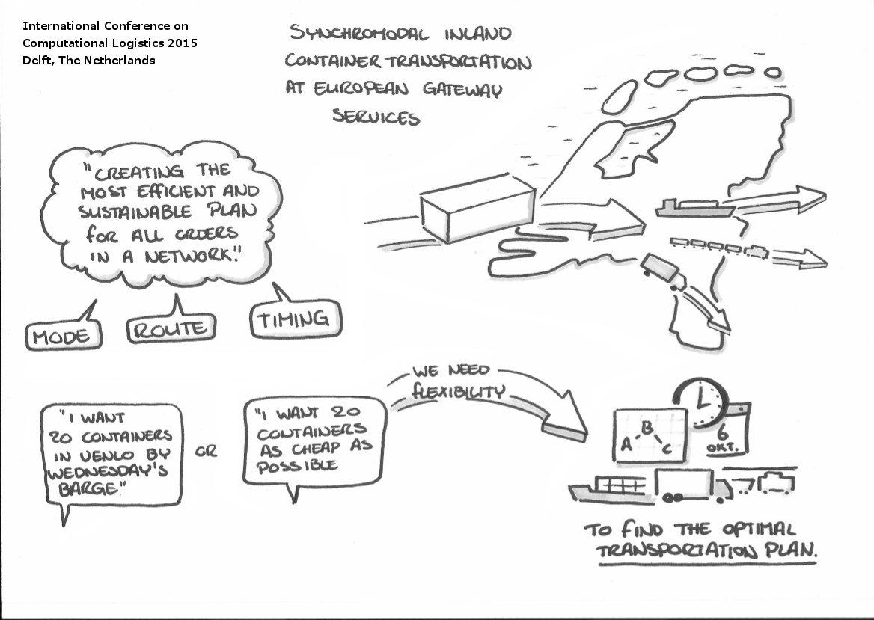
Synchromodality
Objective: A flexible and cooperative transport network using the different means of transport available
The customer can define basic requirements such as transport costs and delivery time
Means of transport are defined by the transport company → Bundling effects
Bundling effects ensure a more efficient use of transport capacities and an increasing use of rail and inland waterway transport.
Prerequisite for success: close cooperation between all players along the supply chain
Integration of visionary modes of transport supports synchromodal systems
Bildquelle: Rudy Negenborn, Delft University of Technology
Notes:
Synchromodality aims to create a flexible and cooperative transport network by making optimal use of the various transport resources available. The main prerequisite for the concept of synchronous modality is that the means of transport is not defined by the customer. When using this concept, the customer can only define basic requirements such as transport costs and delivery time. The free choice of means of transport enables bundling effects that contribute to the efficient use of transport capacities. This means that additional transport routes can be avoided, leading to a reduction in CO2 and other emissions. By using bundling effects and removing the prejudices of decision-makers against alternative modes of transport (rail, inland waterways), the concept can contribute to an increasing use of rail and inland waterway transport. By adding real-time monitoring, it is possible to select the most advantageous means of transport and routes. This leads to an effective use of the infrastructure and a reduction of waiting times. To ensure the success of this approach, close cooperation between all key players along the supply chain is necessary. Members of the synchromodal transport network must coordinate their efforts in order to achieve optimum utilisation of the means of transport and at the same time ensure that all delivery deadlines are met. A lively exchange of data and mutual trust between all key players is therefore imperative.
Source:
Reis, Vasco (2015): Should we keep on renaming a +35-year-old baby? In: Journal of Transport Geography 46, S. 173–179. DOI: 10.1016/j.jtrangeo.2015.06.019.
Picture source:
Rudy Negenborn (2015): ICCL‘15 in Sketch Notes. International Conferene on Computational Logistics 2015. Delft, The Netherlands. URL: http://realtimelogistics.info/iccl/?page_id=854 [17.06.2019]

Slide 36
Vision by 2030: The Physical Internet
Shipment of products via the Internet - on the same basis as information flows!
Open, connected network
Basis: Network of Hubs
Based on
  Physical, digital and operational interconnection
  Basics of the digital Internet
Example: based on data, a container searches for its own route → Algorithms calculate the ideal route themselves
  Inland navigation vessel and train preferred → environmentally friendly
Internet
Shipping of products via the Internet - on the same basis as information flows!
Consignor
Consignee
Physical
Internet
HUB
HUB
HUB
HUB
Customer
Bildquelle: Own ifigure
Notes:
Another innovative transport concept is the Physical Internet. Canadian Professor Benoit Montreuil is considered a pioneer in the field. The basic idea of the Physical Internet is to send freight and information flows over the Internet (Fig. 3). For example, when sending an email, in most cases it is not known which provider is used by the recipient or via which "route" the email reaches the recipient. We rely on the Internet to send the email to the right recipient. In the Physical Internet, this message consists of a physical object such as a package. A network of hubs, which send and receive the products, form the basis for the Physical Internet (this network is modelled on the various servers on the Internet). The nearest hub to the customer/receiver makes the last delivery. In the Physical Internet, all modes of transport and service providers are networked to ensure efficient dispatch and use of the network.
To ensure barrier-free and seamless transport, standardised PI containers, packages, warehouses and transshipment points must be installed. These are connected to the Internet of Things (see Chapter 4.1) and communicate independently with each other. Furthermore, processes must be standardised in order to minimise the risk of discrepancies. These standardised transport units and processes lead to a reliable and resilient smart network in which the units communicate almost independently. This intelligent network should be accessible to all actors in the supply chain (including at global level). This enables the transport units to choose the best transport route themselves and to interact with other transport units and stations. This makes human interaction almost superfluous (e.g. no need to plan a transshipment process). The connection between the key players, the infrastructure and the different modes of transport is essential for the Physical Internet and leads to a comprehensive interconnectivity. The exchange of all relevant information and ensuring that data is up-to-date in real time are also key elements of the Physical Internet concept.
Sources:
Montreuil, Benoit (2011): Toward a Physical Internet: meeting the global logistics sustainability grand challenge. In Logistics Research 3 (2), pp. 71–87. DOI: 10.1007/s12159-011-0045-x.
Modulushca project (2014): Physical Internet. Available online at https://www.youtube.com/watch?v=lltcWVNrjl0, checked on 7/2/2019.
Picture source: Own figure

Slide 37
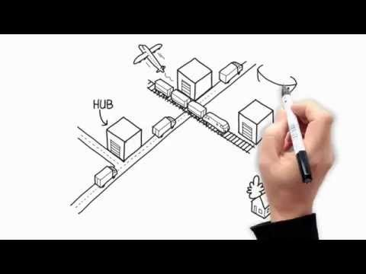
Vision by 2030: The Physical Internet
Notes:
In the YouTube video "Towards Physical Internet Implementation: ALICE research and innovation roadmaps" Physical Internet is explained clearly and easily understandable.
The video shows the various problems that logistics faces, the many different goods, the lack of coordination between the modes of transport, the poor use of the warehouses and the complex networks. The physical Internet offers solutions to these problems, goods are standardized, the modes of transport are interconnected, warehouses are better utilized and the supply chain becomes more coherent.
Video source:
ETP Alice (2015): Towards Physical Internet Implementation: ALICE research and innovation roadmaps. URL: https://www.youtube.com/watch?v=4vc7XoEYUs8

Slide 38
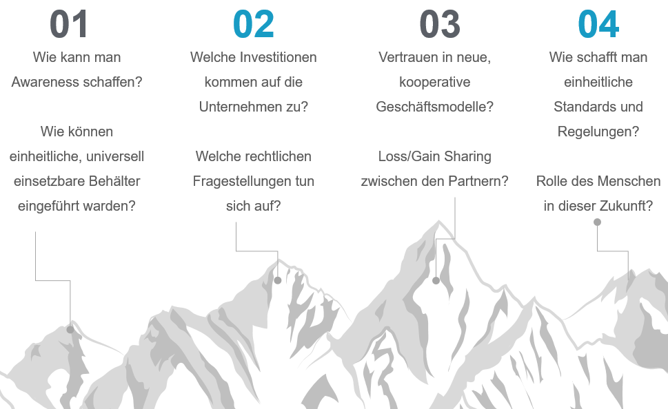
Physical Internet – Many open questions
How can awareness be created?
Which investments will companies have to make?
Confidence in new, cooperative business models?
How can uniform standards and regulations be created?
How can uniform, universally applicable containers be introduced?
Which legal questions arise?
Loss/gain sharing between the partners?
Role of the human being in this future?

Slide 39

Innovative transport concepts
Quiz
Which innovative transport
concepts do you know?
Bildquelle: pixabay
Notes:
Which innovative transport concepts do you know?
Answer: Synchromodality, Physical Internet
Image source:
https://pixabay.com/de/illustrations/hinweistafel-verkehrsschild-richtung-63978/

Slide 40
4-field matrix
Final Exercise
Take a large sheet of paper or a poster and divide it into four fields.
Each of these fields is assigned one of the presentation theme blocks:
  Why we need future trends in freight transport
  Optimisation of existing means of transport
  Visionary means of transport
  Innovative transport concepts
Now write down everything you can think of for each of these topic blocks. These could be things you remember from the presentation you learned in class, where you read it, etc.
Why we need future trends in freight transport
Optimisation of existing means of transport
Visionary means of transport
Innovative transport concepts

Slide 41
References
Aeros (2019a): Applications. Available online at http://aeroscraft.com/applications/4580412718, updated on 6/7/2019, checked on 7/2/2019.
Aeros (2019b): Fleet. Available online at http://aeroscraft.com/fleet-copy/4580475518, updated on 6/7/2019, checked on 7/2/2019.
Aeros (2019c): Key technology. Available online at http://aeroscraft.com/technology-copy/4580412172, updated on 6/7/2019, checked on 7/2/2019.
Amazon.com (2019): Amazon Prime Air. Available online at https://www.amazon.com/Amazon-Prime-Air/b?ie=UTF8&node=8037720011, checked on 7/1/2019.
Aymelek, M.; Boulougouris, E.; Turan, O.; Konovessis, D. (2014): Challenges and opportunities for LNG as a ship fuel source and an application to bunkering network optimisation. In Carlos Soares, T. Santos (Eds.): Maritime Technology and Engineering, vol. 88: CRC Press, pp. 767–776.
BMVIT (2018): MegaWATT rollt an: Die ersten neun Elektro-Trucks ausgeliefert. Available online at https://infothek.bmvit.gv.at/man-in-steyr-praesentation-uebergabe-elektro-trucks/, checked on 7/1/2019.
Budras, Corinna (2015): Cargolifter: Hochfliegende Träume. Frankfurter Allgemeine Zeitung GmbH. Available online at https://www.faz.net/aktuell/finanzen/aktien/hochfliegende-traeume-fuehrten-bei-cargolifter-in-die-insolvenz-13963312.html, checked on 7/2/2019.
Business Upper Austria - OÖ Wirtschaftsagentur GmbH (2017): Erste Flüssigerdgas-Tankstelle in Österreich eröffnet. Available online at https://www.ooe2020.at/rechte-navigation/news-presse/detail/news/erste-fluessigerdgas-tankstelle-in-oesterreich-eroeff/, checked on 7/1/2019.
Cargo Center Graz (2017): Riesendrohne soll 90 Tonnen Ladung transportieren. Available online at http://www.cargo-center-graz.at/news/details/article/riesendrohne-soll-90-tonnen-ladung-transportieren/, checked on 7/1/2019.
Cargo sous terrain AG (2019): Was ist CST. Available online at https://www.cst.ch/was-ist-cst/, checked on 7/1/2019.
Cookson, Graham (2018): INRIX Global Traffic Scorecard. INRIX Research. Available online at https://www.dmagazine.com/wp-content/uploads/2018/02/INRIX_2017_Traffic_Scorecard_Final_2.pdf, checked on 6/17/2019.
Corman, Francesco; Voß, Stefan; Negenborn, Rudy R. (Eds.) (2015): Computational Logistics. Cham: Springer International Publishing (Lecture Notes in Computer Science).
D'Andrea, Raffaello (2014): Guest Editorial Can Drones Deliver? In IEEE Trans. Automat. Sci. Eng. 11 (3), pp. 647–648. DOI: 10.1109/TASE.2014.2326952.
Davies, Alex (2013): This Huge Zeppelin Could Revolutionize The Shipping Industry. Business Insider. Available online at https://www.businessinsider.com/aeroscraft-airship-could-change-avatiation-2013-9?IR=T, updated on 9/9/2013, checked on 7/2/2019.
Derndorfer, Anna: Logistik 4.0. Macher Media House GmbH. Available online at https://diemacher.at/1083/logistik-4, checked on 7/2/2019.
Deutsche Post AG (2019): DHL Paketkopter. Available online at https://www.dpdhl.com/de/presse/specials/dhl-paketkopter.html, updated on 7/1/2019, checked on 7/1/2019.
DLR Transport: Researching the Next Generation Train. Available online at https://verkehrsforschung.dlr.de/en/projects/ngt-cargo, checked on 6/20/2019.
DLR Transport (2017): NGT CARGO: What freight trains of the future will look like. Deutsches Zentrum für Luft- und Raumfahrt (DLR). Available online at https://www.dlr.de/dlr/en/desktopdefault.aspx/tabid-10081/151_read-21934/#/gallery/26733, checked on 6/20/2019.
DLR Transport (2018): Dynamic Virtual Coupling. Available online at https://verkehrsforschung.dlr.de/en/innotrans-2018/dynamisches-fluegeln-1, checked on 7/29/2019.
DP World (2019): DP World Cargospeed. Available online at https://www.dpworld.com/smart-trade/dp-world-cargospeed, checked on 7/1/2019.
DVGW (2019): Mobility with gas and LNG - climate-friendly fuels. Available online at https://www.dvgw.de/english-pages/topics/dvgws-research-and-development-topics/mobility-with-gas-and-lng/, checked on 7/17/2019.
European Commission (2011): White paper on transport. White paper on transport. Roadmap to a single european transport area – towards a competitive and resource-efficient transport system. Available online at https://ec.europa.eu/transport/sites/transport/files/themes/strategies/doc/2011_white_paper/white-paper-illustrated-brochure_en.pdf, checked on 6/5/2019.
European Commission (2018): Multimodal Sustainable Transport: which role for the internalisation of external costs? Available online at https://ec.europa.eu/transport/sites/transport/files/2018-year-multimodality-external-costs-note.pdf, checked on 6/17/2019.

Slide 42
References
European Commission (2011): White paper on transport. White paper on transport. Roadmap to a single european transport area – towards a competitive and resource-efficient transport system. Available online at https://ec.europa.eu/transport/sites/transport/files/themes/strategies/doc/2011_white_paper/white-paper-illustrated-brochure_en.pdf, checked on 6/5/2019.
European Commission (2018): Multimodal Sustainable Transport: which role for the internalisation of external costs? Available online at https://ec.europa.eu/transport/sites/transport/files/2018-year-multimodality-external-costs-note.pdf, checked on 6/17/2019.
European Commission (2019): Urban mobility. Available online at https://ec.europa.eu/transport/themes/urban/urban_mobility_en, updated on 6/17/2019, checked on 6/17/2019.
European Environment Agency (2018): Final energy consumption by mode of transport. Available online at https://www.eea.europa.eu/data-and-maps/indicators/transport-final-energy-consumption-by-mode/assessment-9, checked on 6/17/2019.
European Truck Platooning Challenge: What is Truck Platooning? - EU Truck Platoon Challenge. Available online at https://www.eutruckplatooning.com/About/default.aspx, checked on 6/19/2019.
Explainity (2016): Internet der Dinge einfach erklärt. Available online at https://www.youtube.com/watch?v=yLZbzbO_7yQ, checked on 7/5/2019.
Fraunhofer IML (2019): Drohnentechnik. Available online at https://www.iml.fraunhofer.de/de/abteilungen/b1/verpackungs_und_handelslogistik/autoid/DL_AutoID/dl_aid_drohnentechnik.html, checked on 7/1/2019.
Hawkins, Andrew J. (2018): WARR Hyperloop pod hits 284 mph to win SpaceX competition. Available online at https://www.theverge.com/2018/7/22/17601280/warr-hyperloop-pod-competition-spacex-elon-musk, checked on 7/1/2019.
Heistermann, Frauke; Hompel, Michael ten; Mallée, Torsten (2017): Digitalisierung in der Logistik - Die BVL: Das Logistik-Netzwerk für Fach- und Führungskräfte. BVL - Bundesvereinigung Logistik e.V. Bremen. Available online at https://www.bvl.de/misc/filePush.php?id=35017&name=BVL17+Positionspapier+Digitalisierung+in+der+Logistik, checked on 7/2/2019.
Hybrid Air Vehicles (2016): Airlander - a new price/speed option. Available online at https://www.aerosociety.com/Assets/Docs/Events/Conferences/2016/809/2.%20Airlander%20-%20A%20New%20Price%20Speed%20Option.pdf, checked on 7/2/2019.
INRIX (2016): Traffic Scorecard. 2015. Available online at http://inrix.com/wp-content/uploads/2016/11/INRIX_2015_Traffic_Scorecard.pdf, checked on 6/17/2019.
INRIX (2019): Interactive Ranking & City Dashboards. Available online at http://inrix.com/scorecard/, checked on 6/17/2019.
IVECO (2018): New Stralis NP. Available online at https://www.iveco.com/Common/Documents/Brochures/new_stralisNP.pdf.
Maibach, Markus; Ickert, Lutz; Sutter, Daniel (2016): Volkswirtschaftliche Aspekte und Auswirkungen des Projekts Cargo Sous Terrain (CST). INFRAS. Available online at https://www.infras.ch/media/filer_public/0f/cd/0fcdaed1-1bc3-42a5-a7f1-22a3481b2cac/cst_infras_schlussbericht-23092016.pdf, checked on 7/1/2019.
MAN Truck & Bus AG (2019): Electric trucks in action – MAN and CNL begin practical testing | MAN Truck Germany. Available online at https://www.truck.man.eu/de/en/man-world/man-in-germany/press-and-media/Electric-trucks-in-action-_-MAN-and-CNL-begin-practical-testing-343552.html, updated on 7/28/2019, checked on 7/29/2019.
Modulushca project (2014): Physical Internet. Available online at https://www.youtube.com/watch?v=lltcWVNrjl0, checked on 7/2/2019.
Montreuil, Benoit (2011): Toward a Physical Internet: meeting the global logistics sustainability grand challenge. In Logistics Research 3 (2), pp. 71–87. DOI: 10.1007/s12159-011-0045-x.
Murray, Tom (2018): Inside the world's largest aircraft, which is set to have glass floors and take wealthy travellers on luxury 3-day expeditions. Business.Insider.Deutschland. Available online at https://www.businessinsider.de/inside-the-worlds-largest-aircraft-airlander-10-wealthy-travelers-on-luxury-3-day-expeditions-2018-7?r=US&IR=T, updated on 7/24/2018, checked on 7/2/2019.
NGVA Europe (2019): Stations map. Available online at https://www.ngva.eu/stations-map/, checked on 7/1/2019.
OMV AG (2019): CNG for passenger cars and commercial vehicles. Available online at https://www.omv.com/en/cng, checked on 7/5/2019.
Österreichische Post AG (2019): E-Mobilität. Available online at https://www.post.at/co2neutral/e_mobilitaet.php, checked on 7/1/2019.

Slide 43
References
Pluta, Werner (2019): Luftschiff: Der Airlander wird gebaut. Available online at https://www.golem.de/news/luftschiff-der-airlander-wird-gebaut-1901-138702.html, checked on 7/2/2019.
Polly, Stefan (2018): Drohnen in der Landwirtschaft: Was die kleinen Überflieger leisten | Landwirtschaftskammer - Technik. Available online at https://noe.lko.at/drohnen-in-der-landwirtschaft-was-die-kleinen-%C3%BCberflieger-leisten+2500+2800345, checked on 7/1/2019.
Port Technology (2019): Autonomous Shipping Project Wins EU Investment. Available online at https://www.porttechnology.org/news/autonomous_shipping_project_wins_eu_investment, checked on 6/19/2019.
Proissl, Anneliese (2019): Erdgas-Lkw: Umweltschonend, aber unbeliebt beim Staat. Available online at https://www.trend.at/branchen/auto-mobilitaet/erdgas-lkw-umweltschonend-staat-10597689.
Rathmann, Matthias (2018): Erdgas rechnet sich. Spediteure prüfen Einsatz von LNG. Available online at https://www.eurotransport.de/artikel/erdgas-rechnet-sich-spediteure-pruefen-einsatz-von-lng-10486265.html.
Reis, Vasco (2015): Should we keep on renaming a +35-year-old baby? In Journal of Transport Geography 46, pp. 173–179. DOI: 10.1016/j.jtrangeo.2015.06.019.
RIS (2019): Luftfahrtgesetz, Fassung vom 01.07.2019. Available online at https://www.ris.bka.gv.at/GeltendeFassung.wxe?Abfrage=Bundesnormen&Gesetzesnummer=10011306, checked on 7/1/2019.
Rogers, David (2015): Blimps are back: Giant airship goes on sale. Available online at http://www.globalconstructionreview.com/innovation/blimp8s-a8r8e-b6ac8k-gi0a8nt4-0a6i4r2sh08ip/, checked on 7/2/2019.
Rolls-Royce (2016): Autonomous ships. The next step. Available online at https://www.rolls-royce.com/~/media/Files/R/Rolls-Royce/documents/customers/marine/ship-intel/rr-ship-intel-aawa-8pg.pdf, checked on 6/19/2019.
Sims, R.; Schaeffer, R.; Creutzig, F.; Cruz-Núñez, X.; D’Agosto, M.; Dimitriu, D. et al. (2014): Transport. In O. Edenhofer, R. Pichs-Madruga, Y. Sokona, E. Farahani, S. Kadner, K. Seyboth et al. (Eds.): Climate Change 2014: Mitigation of Climate Change. Contribution of Working Group III to the Fifth Assessment Report of the Intergovernmental Panel on Climate Change. Cambridge, United Kingdom and New York, NY, USA: Cambridge University Press. Available online at https://www.ipcc.ch/site/assets/uploads/2018/02/ipcc_wg3_ar5_full.pdf, checked on 6/17/2019.
SpaceX (2013): Hyperloop Alpha. Available online at https://www.spacex.com/sites/spacex/files/hyperloop_alpha-20130812.pdf, checked on 7/1/2019.
STANDARD Verlagsgesellschaft m. b.H. (2019): Bei Flüssiggas steht Österreich auf der Bremse – noch. Available online at https://derstandard.at/2000102771169/Bei-Fluessiggas-steht-Oesterreich-auf-der-Bremse-noch, checked on 7/1/2019.
Taylor, Catherine L.; Hyde, David J.; Barr, Lawrence C. (2016): Hyperloop Commercial Feasibility Analysis : High Level Overview. With assistance of John A. Volpe National Transportation Systems Center (U.S.). Available online at https://rosap.ntl.bts.gov/view/dot/12308.
UPS (2017): UPS Tests Residential Delivery Via Drone Launched From atop Package Car. Available online at https://pressroom.ups.com/pressroom/ContentDetailsViewer.page?ConceptType=PressReleases&id=1487687844847-162, checked on 7/1/2019.
VCÖ (2016): Der urbane Gütertransport der Zukunft ist emissionsfrei. Available online at https://www.vcoe.at/files/vcoe/uploads/News/VCOe-Factsheets/2016-02%20-%20Der%20urbane%20Guetertransport%20der%20Zukunft%20ist%20emissionsfrei/VC%C3%96-Factsheet%20Urbaner%20G%C3%BCtertransport.pdf, checked on 7/1/2019.
Virgin Hyperloop One (2019): Hyperloop One Global Challenge. Available online at https://hyperloop-one.com/global-challenge, updated on 6/26/2019, checked on 7/1/2019.
Werner, Max; Eissing, Klaus; Langton, Sebastian (2016): Shared Value Potential of Transporting Cargo via Hyperloop. In Front. Built Environ. 2, p. 11. DOI: 10.3389/fbuil.2016.00017.
Winter, Joachim; Böhm, Mathias; Malzacher, Gregor (2017): Future Europe-Asia trains. In Baltic Transport Journal. Available online at https://www.researchgate.net/publication/321211758_Future_Europe-Asia_trains.
Zipline (2019): Our Impact. Available online at https://flyzipline.com/impact/, updated on 5/27/2019, checked on 7/1/2019.

Slide 44


Further information
We hope our set of slides have met your expectations!
- you are free to use, adapt and share these slides and to use them for your lectures.
For questions and feedback please do not hesitate to contact us:
retrans@fh-steyr.at
Further set of slides are available at:
http://www.reecotrans.at/de/

